Slide 1
Machine Learning

Slide 2
What is machine Learning?
Machine learning is the field of study that gives the computer the ability to learn without being explicitly programmed.
-Arthur Samuel

Slide 3
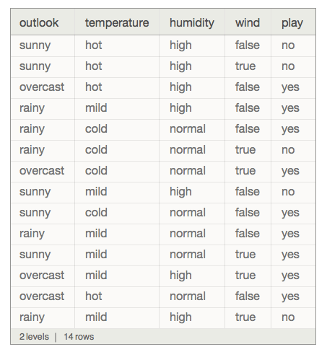
What is a dataset?
A collection of data is called dataset.
It is mostly in the form of text and images.

Slide 4
Preprocessing - IMPUTING
The dataset should not contain any missing values, The missing values in dataset should be processed in order to proceed further.
Class | Group 1 | Group 2
Class 1 | 82 | 95
Class 2 |  | 88
Class 3 | 84

Slide 5

Replacing The Missing Values
Mean
Median
Most Frequent

Slide 6
Processing Categorical Data
Country(Categorical) | Country(Numerical)
GERMANY | 1
FRANCE | 0
ITALY | 2
Mathematical algorithms will not work under categorical data. They must be encoded into some numerical form to proceed further.

Slide 7
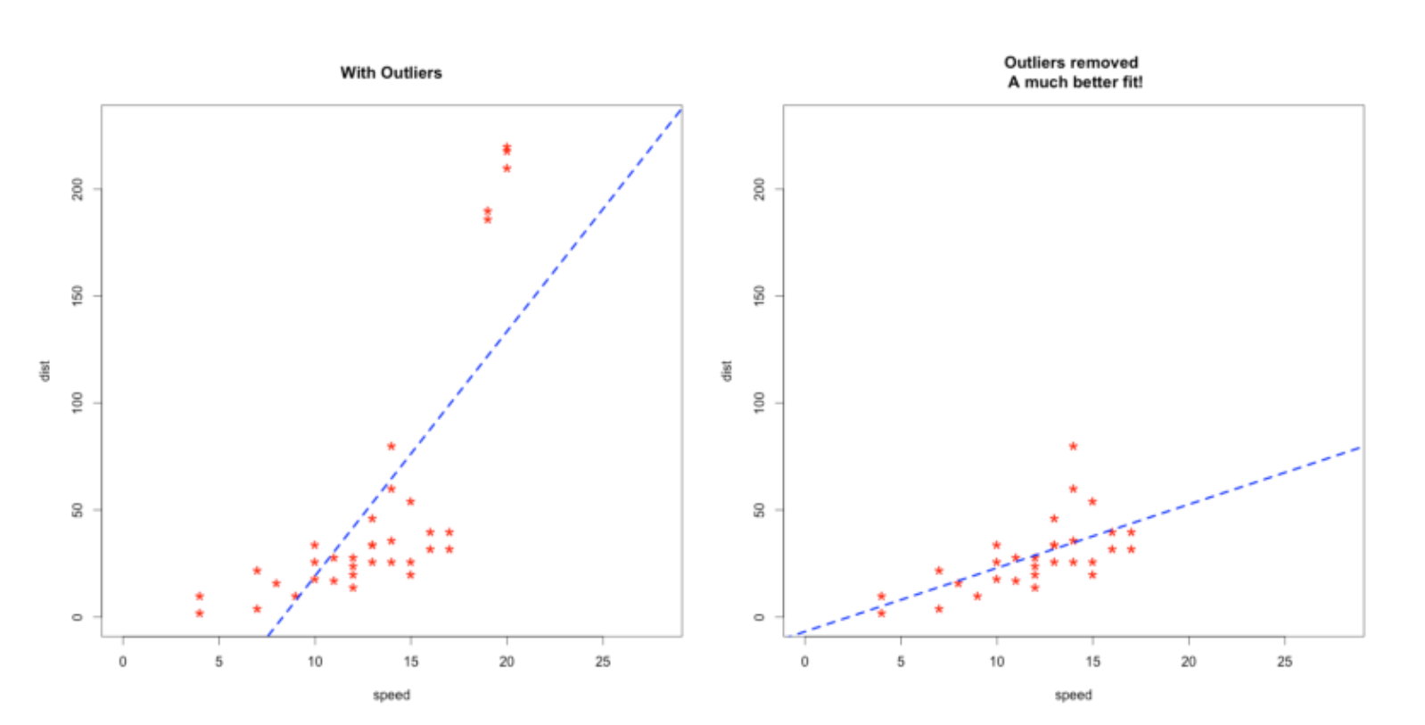
Standardization AND normalization
Outliers will greatly affect the model’s performance and it must be processed before moving further.

Slide 8
TYPES of Machine learning
Supervised Learning.
Unsupervised Learning.
Semi supervised Learning.
Reinforcement Learning.

Slide 9
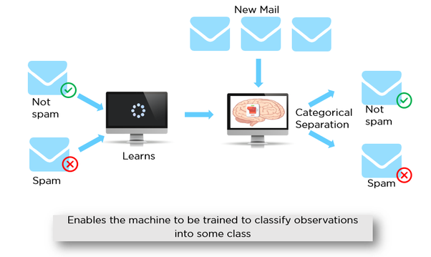
Supervised Machine Learning
In supervised machine learning the training data will contain desired outputs. A typical example would be a spam filter.

Slide 10
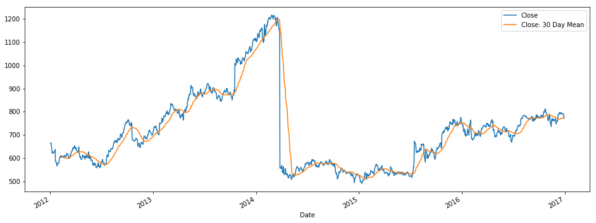
Regression
Regression is used to forecast future values from the training dataset.
Example whether forecast, share market prediction etc.,

Slide 11
Simple linear regression
Simple linear regression has one independent variable and one dependent variable. X and y.
Y = b0 + b1 * X1
Y => Dependent Variable.
X => Independent Variable.
B0 => Constant.
B1 => Coefficient of the independent variable.

Slide 12
Multiple linear regression
Is same as simple linear regression but it has many independent variables.
y = b0 + b1x1 + b2x2 + … + bnxn

Slide 13

CLASSIFICATION
Classification is used to predict a category.
It is nothing but identifying which category an object belongs to.
Example: Classifying whether an email is spam or not.

Slide 14
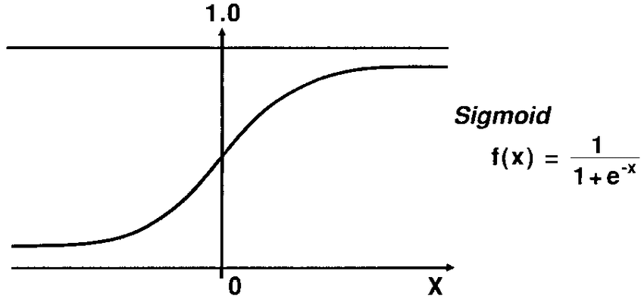
LOGISTIC REGRESSION
Logistic regression uses sigmoid function to classify objects.

Slide 15
Support vector machines
Support vector machine is a classifier that finds an optimal hyperplane that maximizes the margin between two classes.
- Applied Machine learning Algorithms by Derek Jadamski

Slide 16
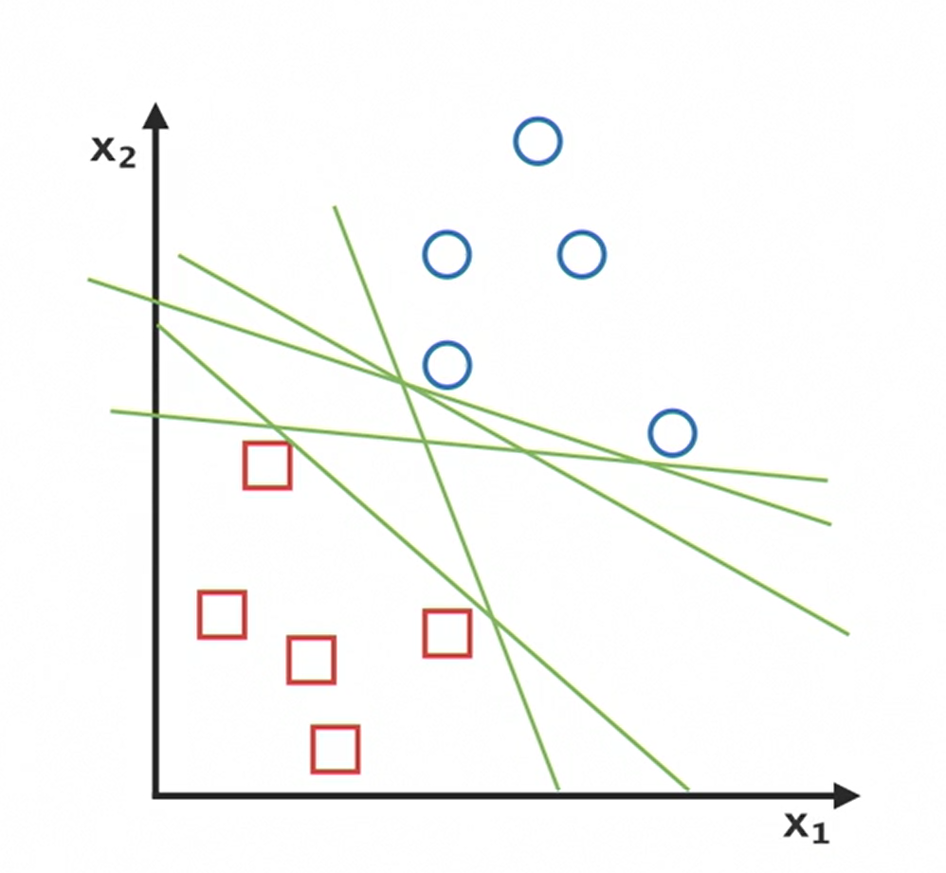
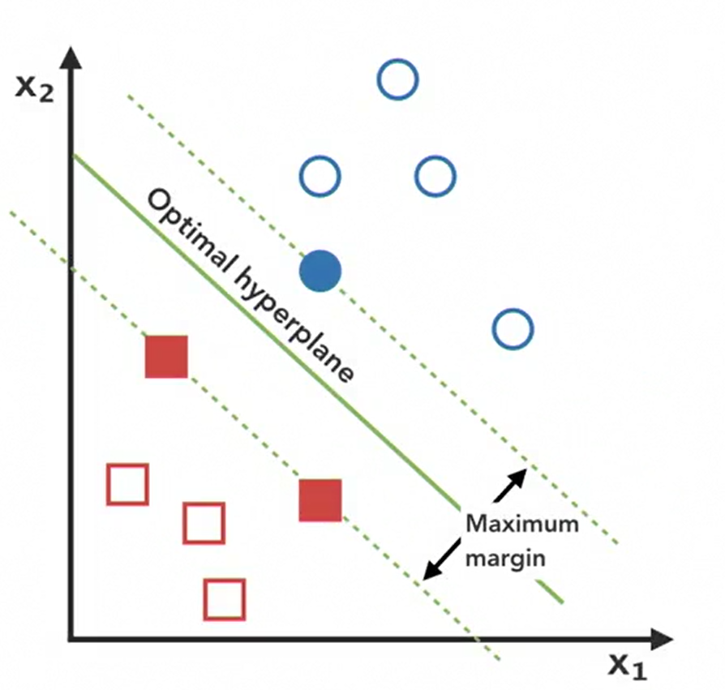
SVM FINDING OPTIMAL HYPERPLANE

Slide 17
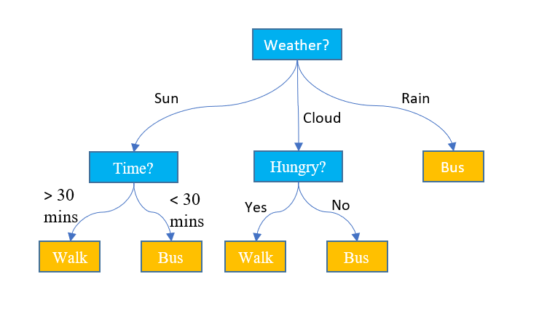
DECISION TREES
A versatile machine learning algorithm which can perform both classification and regression tasks.

Slide 18
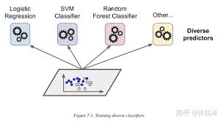
RANDOM FORESTS
An ensemble algorithm which uses decision trees underneath.
Ensemble is the aggregation of group of predictors for predictors.

Slide 19
SIMPLE NLP TRICK
Step 1: Convert the sentence to lowercase.
Step 2: Remove unreadable words.
Step 3: Convert the sentence into tokens.
Step 4: Remove Stop words and Punctuation.
Step 5: Join the sentence.

Slide 20
UNSUPERVISED LEARNING
In Unsupervised Machine learning the dataset will only contain independent variable and it does not contain dependent variable.
We use clustering algorithms to perform unsupervised machine learning.

